Slide 1


Bank Management System & Personal Bank
Ksenia Studilina Saulo Moreira da Silva

Slide 2

Customer relationship management
Bank CRM
Manage customers data
Manage accounts
Keep track of transactions
Generate reports
Software solutions for businesses that facilitate interaction with customers

Slide 3

Customer personal systems
Personal banking
Keep track of finances
Perform transactions
Update personal data
Software solutions for customers that help to keep track of personal information and use business services

Slide 4
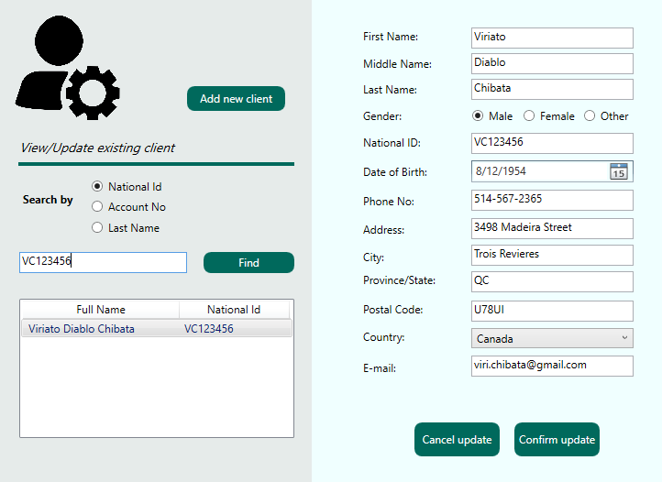
Bank Management System Functionality Overview
Managing customers
Add new customers
Update existing customers
Gather customers’ information

Slide 5
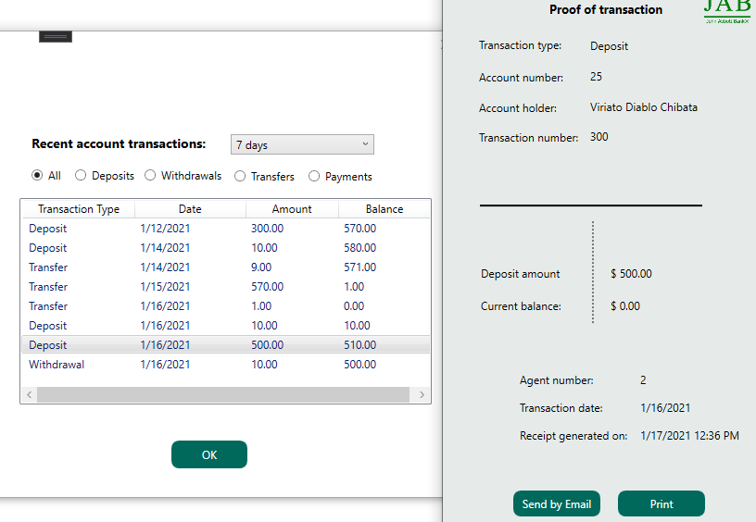
Bank Management System Functionality Overview
Managing accounts and transactions
Add/Update/Close account
Perform and keep record of transactions
Generate receipts
Generate monthly statements

Slide 6
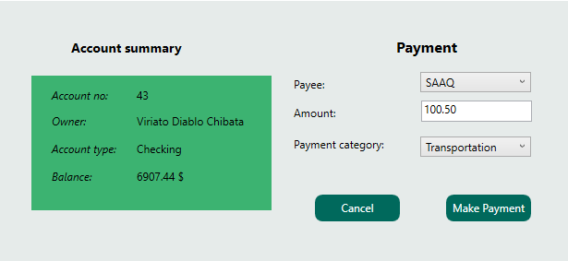
Personal Bank Functionality Overview
Perform account functions
View balance
Make transactions
Generate receipts

Slide 7
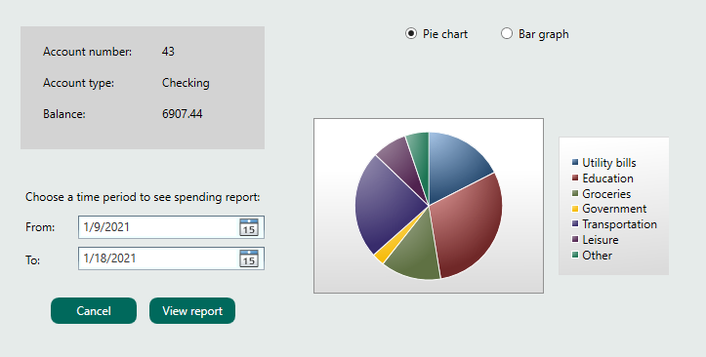
Personal Bank Functionality Overview
Keep track of spending
Visual spending representation
over any time period

Slide 8
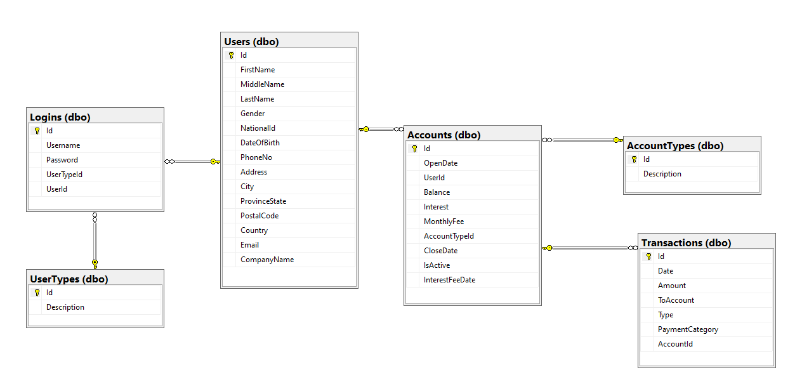
Database structure

Slide 9

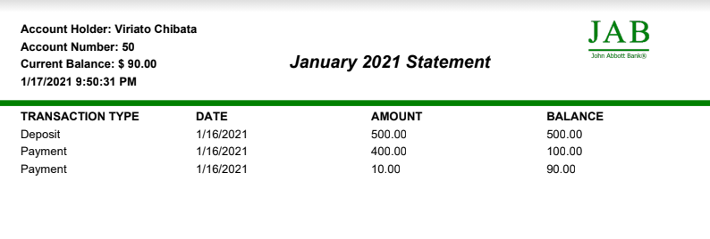


Challenges and Solutions
PDF creation
How to turn a ListView of transactions with a GridView into a PDF document ?
PDFSharp
PDF library creates empty PDF document
Offers solutions to draw graphical elements on it

Slide 10
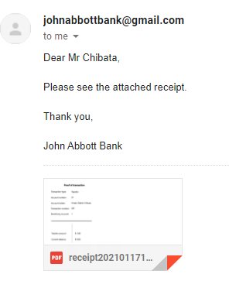
Challenges and Solutions
Sending E-mail
How to send generated PDF by E-mail ?
SmtpClient Class
Allows applications to send email by using the Simple Mail Transfer Protocol
Attachment Class allows to attach existing file to email

Slide 11
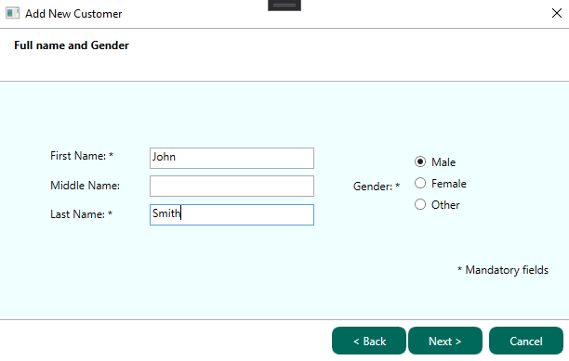
Challenges and Solutions
Adding customer with the help of wizard
How to create a wizard that will require to enter new customer information step by step?
WFP Extended Toolkit
Allows to create multipage wizard

Slide 12
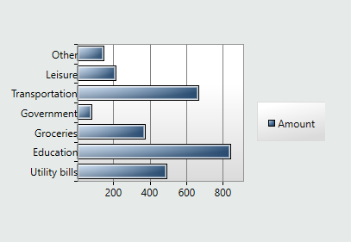
Challenges and Solutions
Visualize data
How to create a graph that will visually represent information about transactions?
System.Windows.Controls.DataVisualization.Toolkit
Allows to create various types of graphs

Slide 13
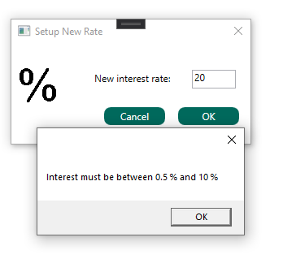
Challenges and Solutions
Entities validation
How to validate data before inserting it to database?
IValidatableObject Interface
Provides a way for an object to be validated when method SaveChanges() is called

Slide 14
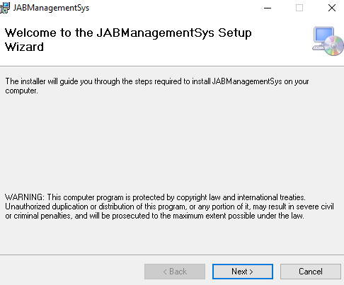
Challenges and Solutions
Installer
How to create an installer for the program?
MS Visual Studio Installer Projects
Official Microsoft extension for Visual Studio that allows to create WPF Setup Installer

Slide 15
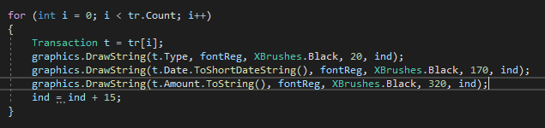




In Details: How to create PDF
6. Draw a table with the help of XGraphics and font
1. Install Pdfsharp library
2. Create an empty PDF document and add first page
3. Create a font
5. Draw string or line with the help of XGraphics and font
4. Drawing is done with XGraphics object

Slide 16
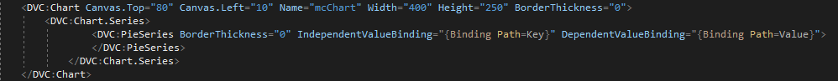
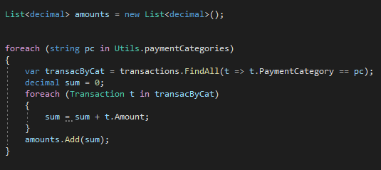
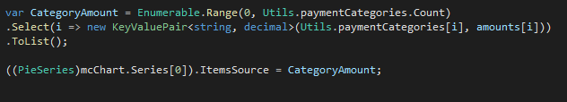
In Details: How to create a pie chart
1. Install System.Windows.Controls.DataVisualization.Toolkit
2. In XAML add Chart and Series (depend on the type of desired chart)
3. To load data to pie chart

Slide 17
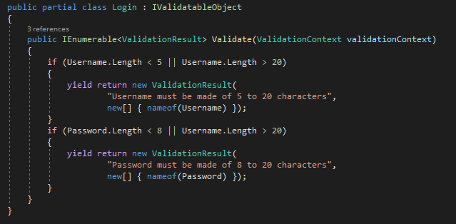
In Details: How to validate entities
1. Add Ivalidatable Object Interface to class

Slide 18
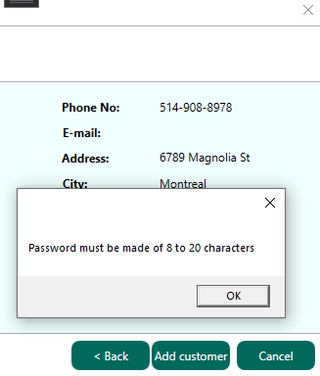
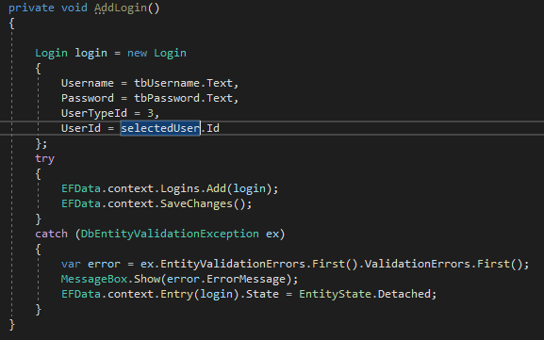
In Details: How to validate entities
2. Catch DbEntityValidationException

Slide 19
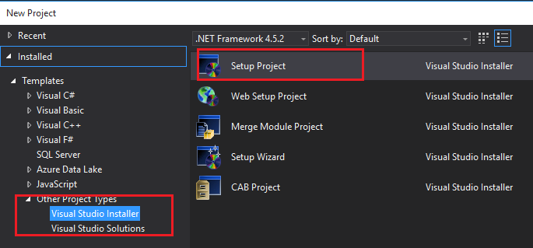
In Details: How to create a program installer
1. Install MS Visual Studio Installer Projects
2. Create new WPF Project of type Visual Studio Installer
3. Create project output and include all files and dependencies

Slide 20

In Details: How to create a program installer
4. Press ‘Batch Build’ To build the installer
5. Find .exe file and install it

Slide 21




Future development
Banking Automatization
Loans and Credit
Banking standards
Fees, Interest, Dividends
Issue loans and credit cards
Implement interest charge
Account number, branch number, institution number

Slide 22

Summary
Bank Management System
Clients
Accounts
Transactions
Reports
Statements
Receipts
Client Personal Banking
Accounts
Transactions
Personal data
Spending reports
Monthly statements

Slide 23

Thank You

